Slide 1
PeeGee Full Organizer
Final Year Project – University of Nicosia - May 2018
Pierre Ghaly – U153N0003
Project Advisor: Prof. Constandinos Mavromoustakis
Notes:
PG is my branding
PG represents my family
Feel free to stop me at anytime for questions

Slide 2
What is PeeGee Full Organizer?
Android application
Organizer for daily basis needs
Notes:
All the functions someone might need to organize the day or goals

Slide 3
What does the app do?
Alarm
Repeated / Once
Notification
Snooze
Reset on reboot

Slide 4
What does the app do?
Notes
Title
Text

Slide 5
What does the app do?
To-do list
Tasks done / not done
Sorting on spot
Progress

Slide 6
What does the app do?
Reminders
Title
Location
Description
Date and time
Alarm
Alarm notification

Slide 7
How?
Environment
Android Studio
Java
Minimum SDK version: API 26
Android 8 (Oreo)

Slide 8
How?
Firebase Authentication
Pricing
Sign-up methods
Users / Accounts monitoring
UI
Firebase Database
Pricing
About Real-Time Database
Security rules

Slide 9
How?
Room Database
About Room Persistence Library
Use of local database
Offline database
Notes:
When can offline database be useful?
- No internet
- No user logged in
- Application not launched
...
In the app case for alarms

Slide 10
How?
Butter Knife
Library by Jake Wharton
Binding variables with layouts
Binding events with layouts
Recycler View
Recycler view
Recycler view adapter
View holder

Slide 11
How?
Apache Commons
Java Collections Framework
Predicate
Collection Utils

Slide 12
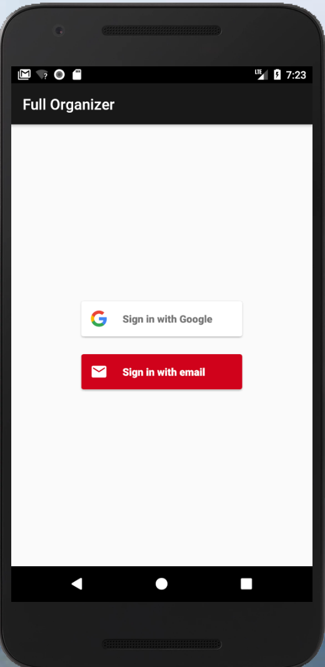
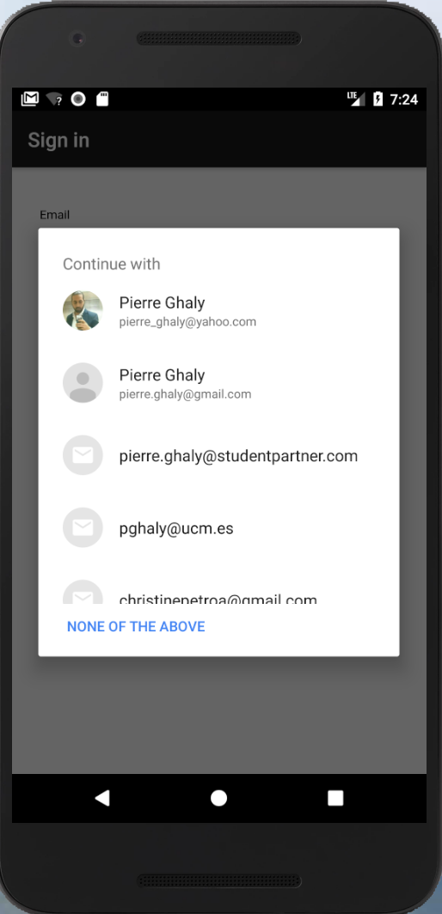
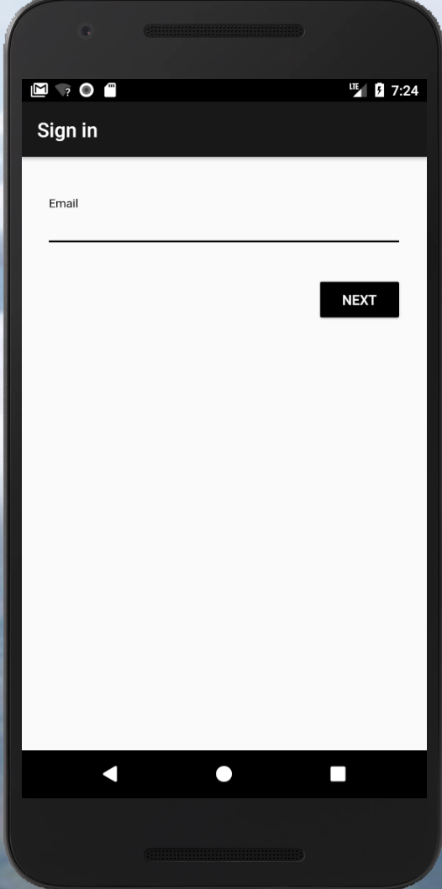
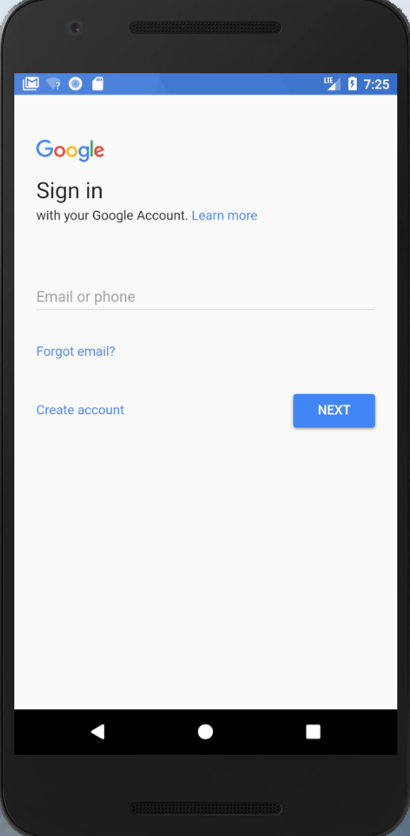
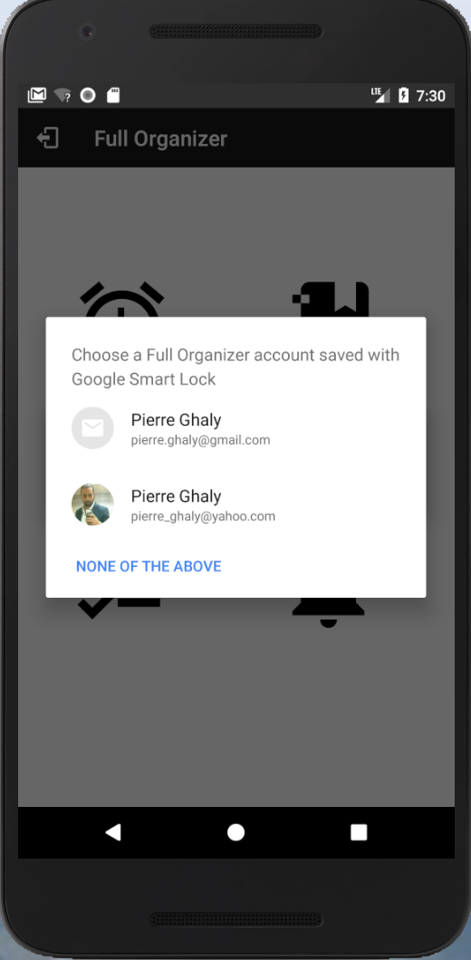
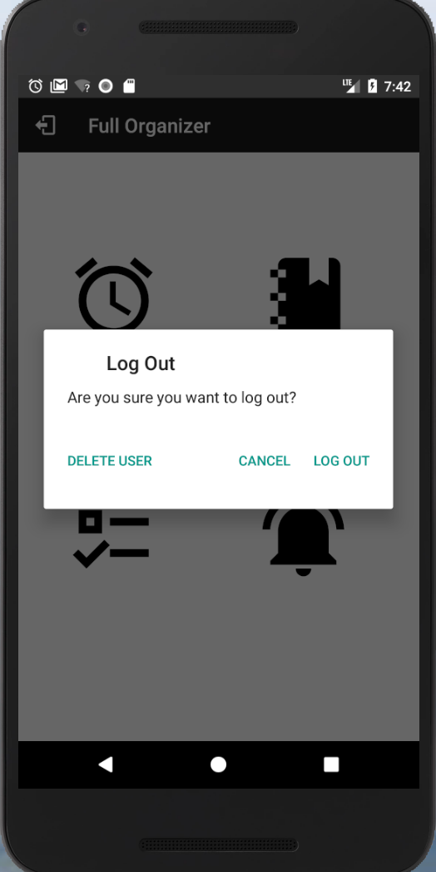
Login

Slide 13
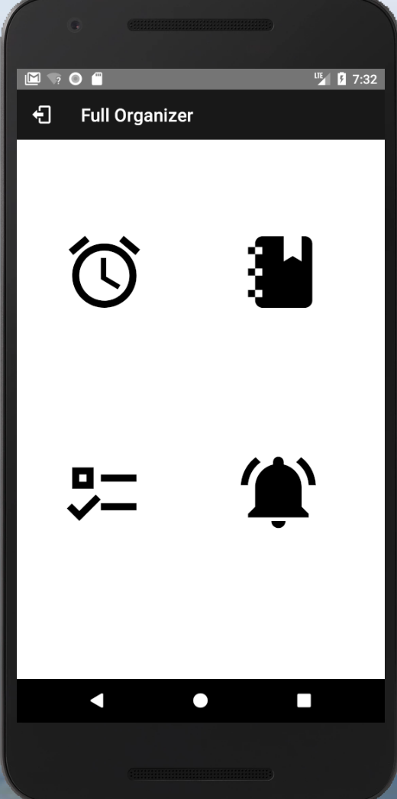
Main Activity

Slide 14
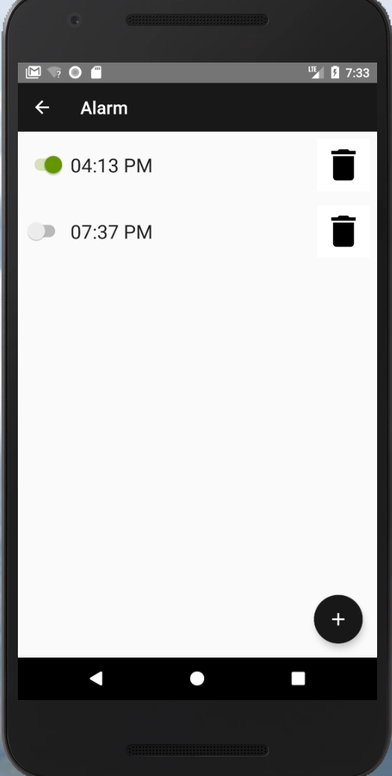
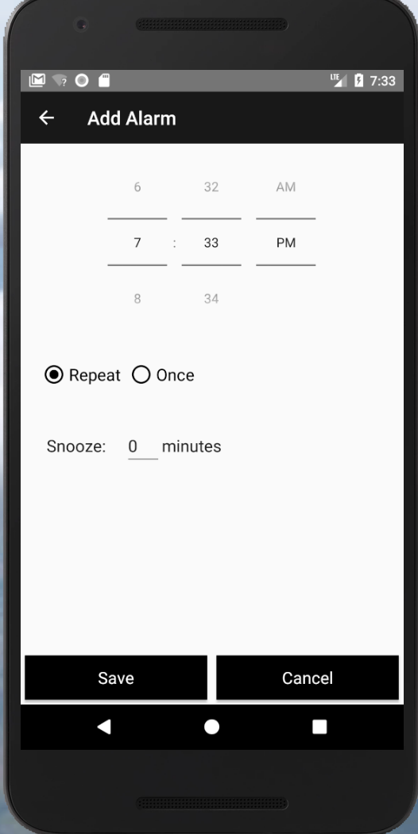
Alarm

Slide 15
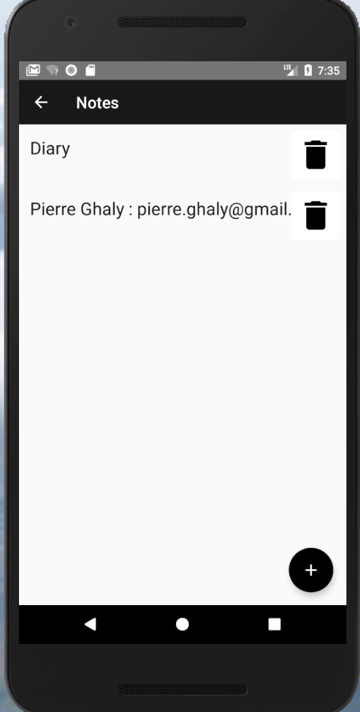
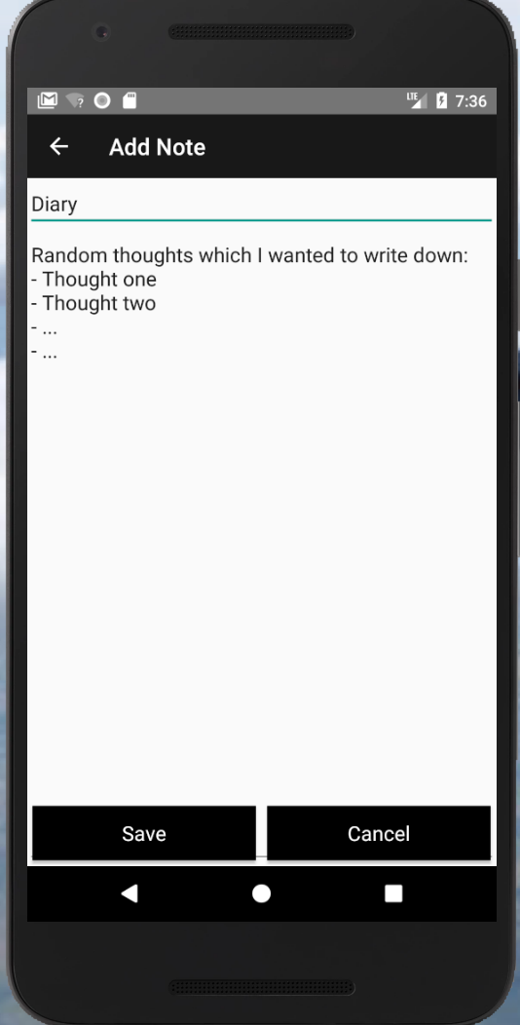
Notes

Slide 16
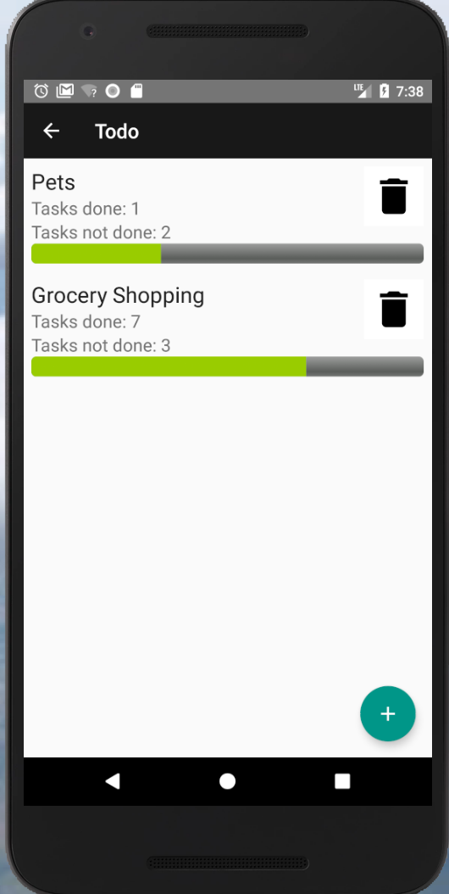
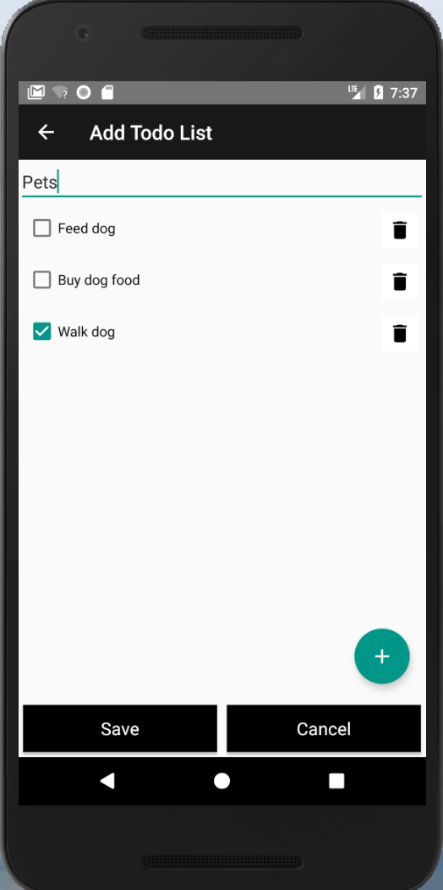
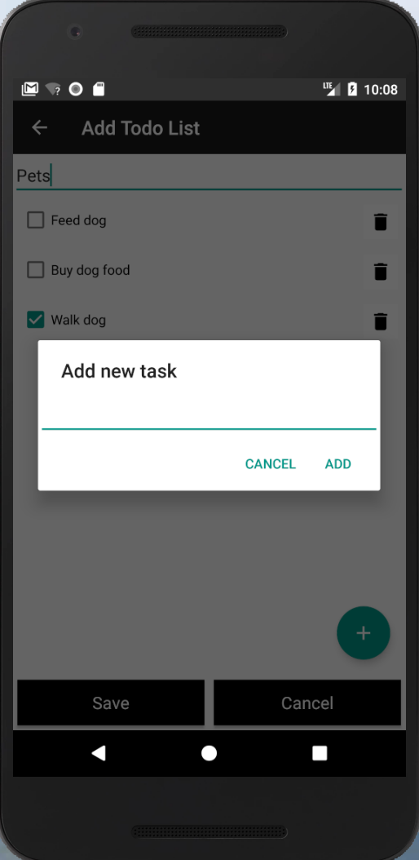
To-Do List

Slide 17
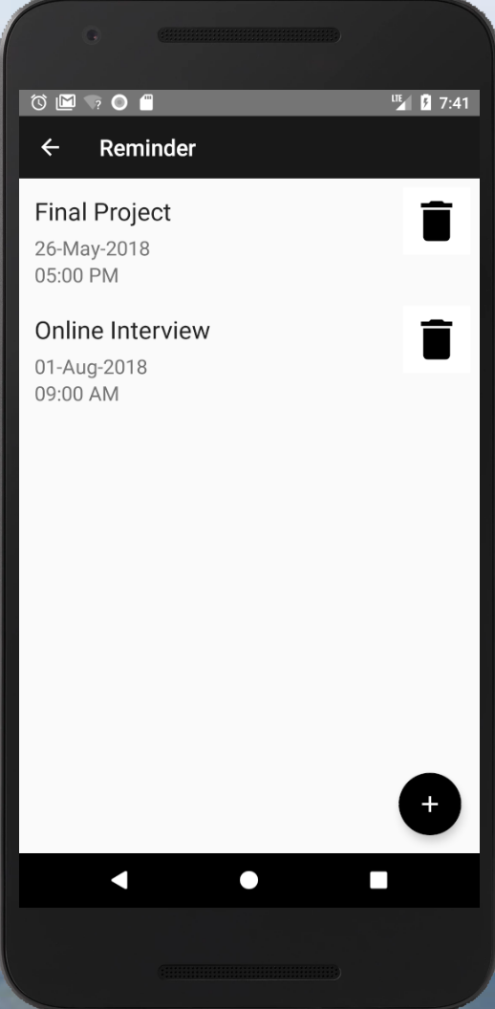
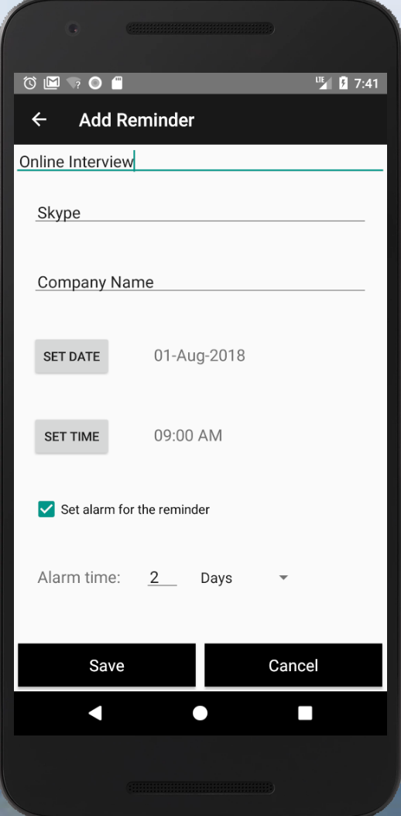
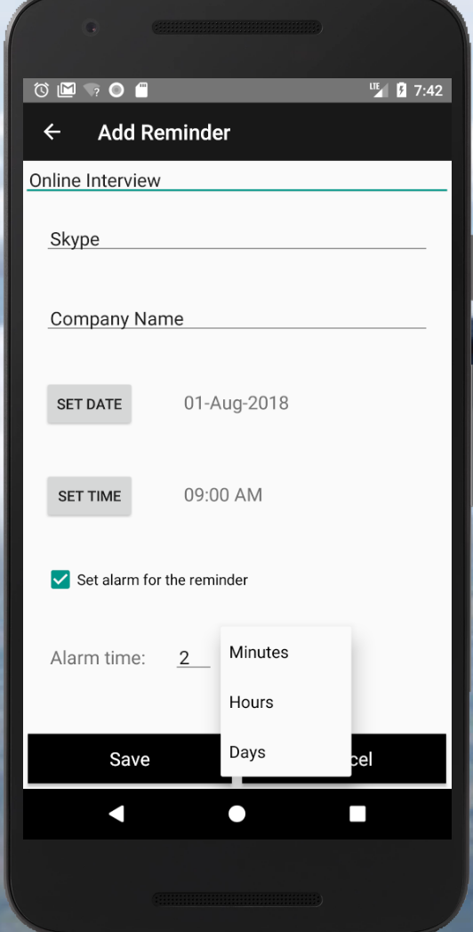
Reminders

Slide 18
Any Questions?

Slide 19
Demo

Slide 20
Thank you!

